Slide 1


SAP UI5 & FIORI with OData TRAINING using BAS
Anubhav Oberoy
Day – 16

Slide 2

Agenda – Day 16
Understanding the CORS Policy Issue
Integrating the OData in Fiori App
Binding our app with Odata properties
Supporting the Pagination
Getting the Associated Data
Making the POST call using the UI
Making Update call from UI

Slide 3
CORS – Cross Origin Resource Sharing
It is a browser security policy which prevent us connecting to a domain while running web page on a different domain.
Browser
S
https://workspaces-ws-7qbs5-app3.eu10.trial.applicationstudio.cloud.sap/
Proxy
Facebook.com
Google.com
Another Server
http://103.207.171.202:8021/sap/opu/odata/sap/ZOCT_ODATA_SRV/$metadata
https://www.npmjs.com/package/@sap/ux-ui5-tooling

Slide 4
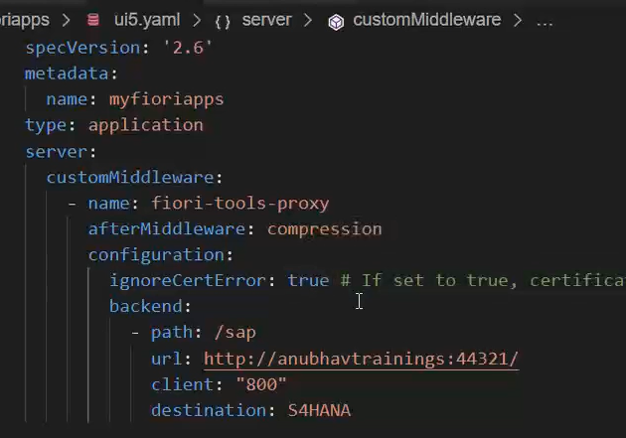
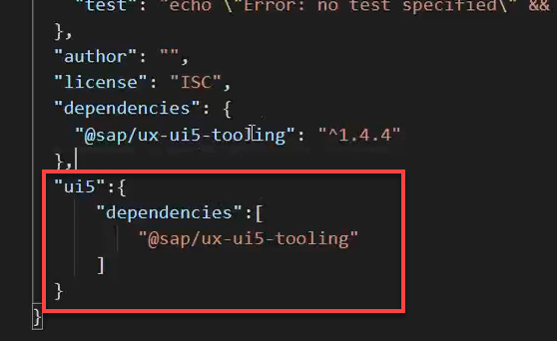
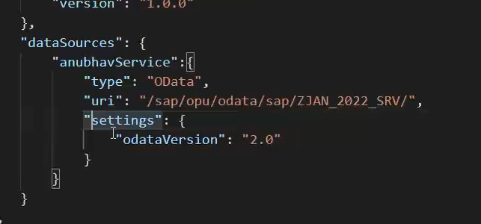
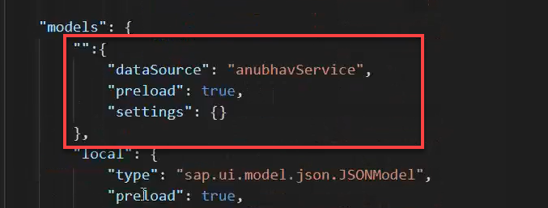
Integrating OData in Fiori App
Before we start OData integration in our fiori project we need have to check that, we have added the package.json and ui5.yaml file in our project, if the we haven’t add then run these commands in the terminal to added these files:
npm init
ui5 init
Now we have the required file in the project, we can proceed the integration.
Go to ui5.yaml file and add the middleware code (given in the link) to the file and save it.
Add the dependency of sap/ux-ui5-tooling to the project using the command: npm install @sap/ux-ui5-tooling
Now add the ui5 section in the package.json file to specify the dependencies related to ui5.
Now go to the manifest.json file we have to add a dataSource under the sap.app section and then create a default model to consume the service in UI.

Slide 5
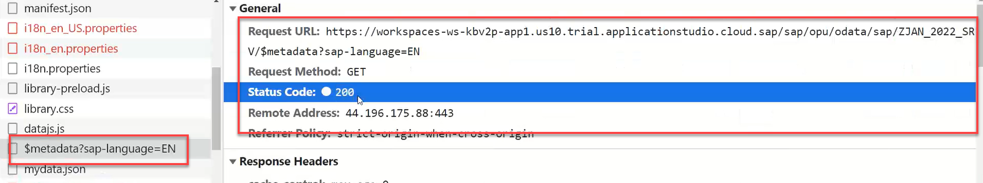
Hands – on: Consume OData service
Follow the steps given in the previous slide to configure the fiori app in BAS to consume the Odata service.
Once the configuration is complete the app will call the metadata of the application which we can check in the Network tab in browser.
Code Link:-
ui5.yaml
package.json
manifest.json

Slide 6
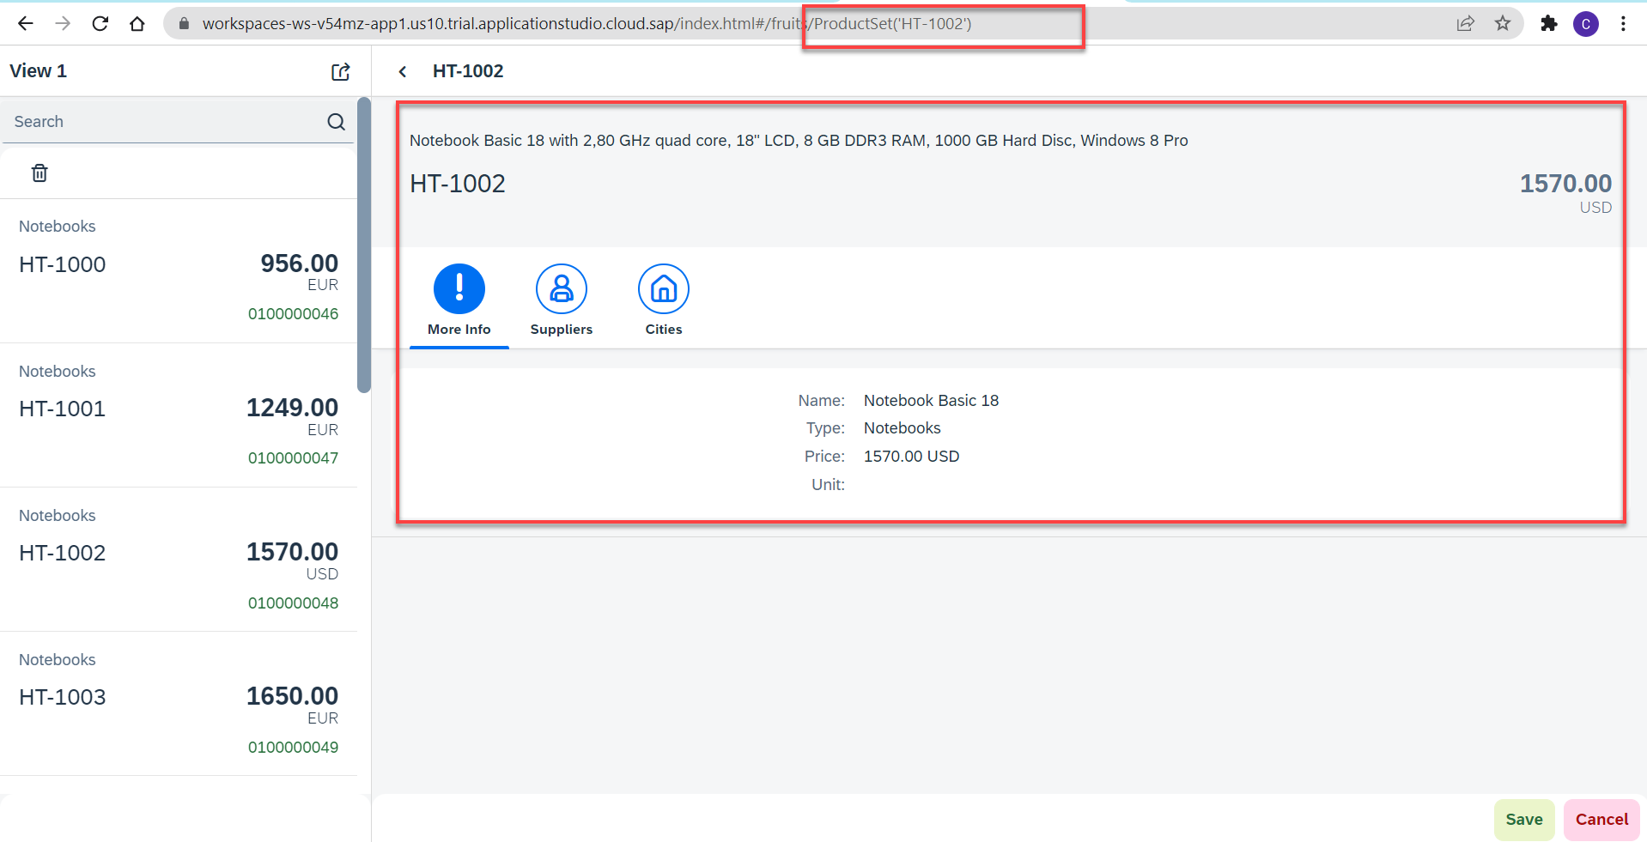
Hands – on: Binding the app with odata
Now to get the data into the application we have to change the binding of the application. Initially the app is bind to the fruits data, so we have to bind it form the OData properties.
We also have to change the Route Match Handler (herculis) code in the View2 controller.
We have to add the growing property to the list to support pagination.
And we also have to change the search function to support the filter on the CATEGORY.
Code Link:-
View1.view.xml
View1.controller.js
View2.view.xml
View2.controller.js
moreInfo.fragment.xml

Slide 7
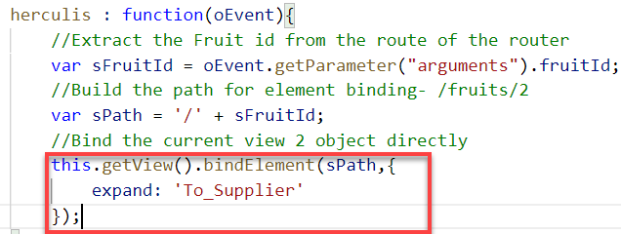
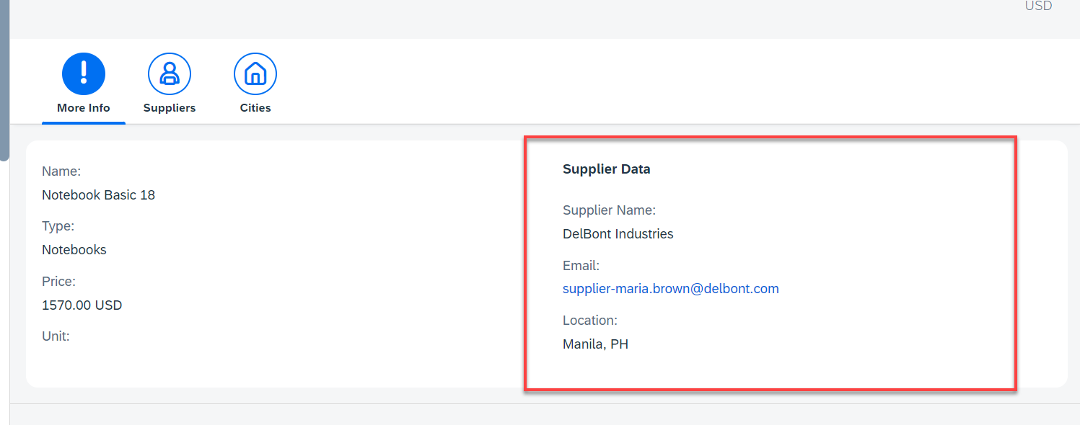
Hands – on: Getting the Associated Data
Now we want load the associated data on the UI. To do that we will create a new form in the moreInfo Fragment and in that form we will load the Supplier data of the product.
We will also have to make some changes in the Binding of the View2 to load the dependent data.
Code Link:-
View2.controller.js
moreInfo.fragment.xml

Slide 8
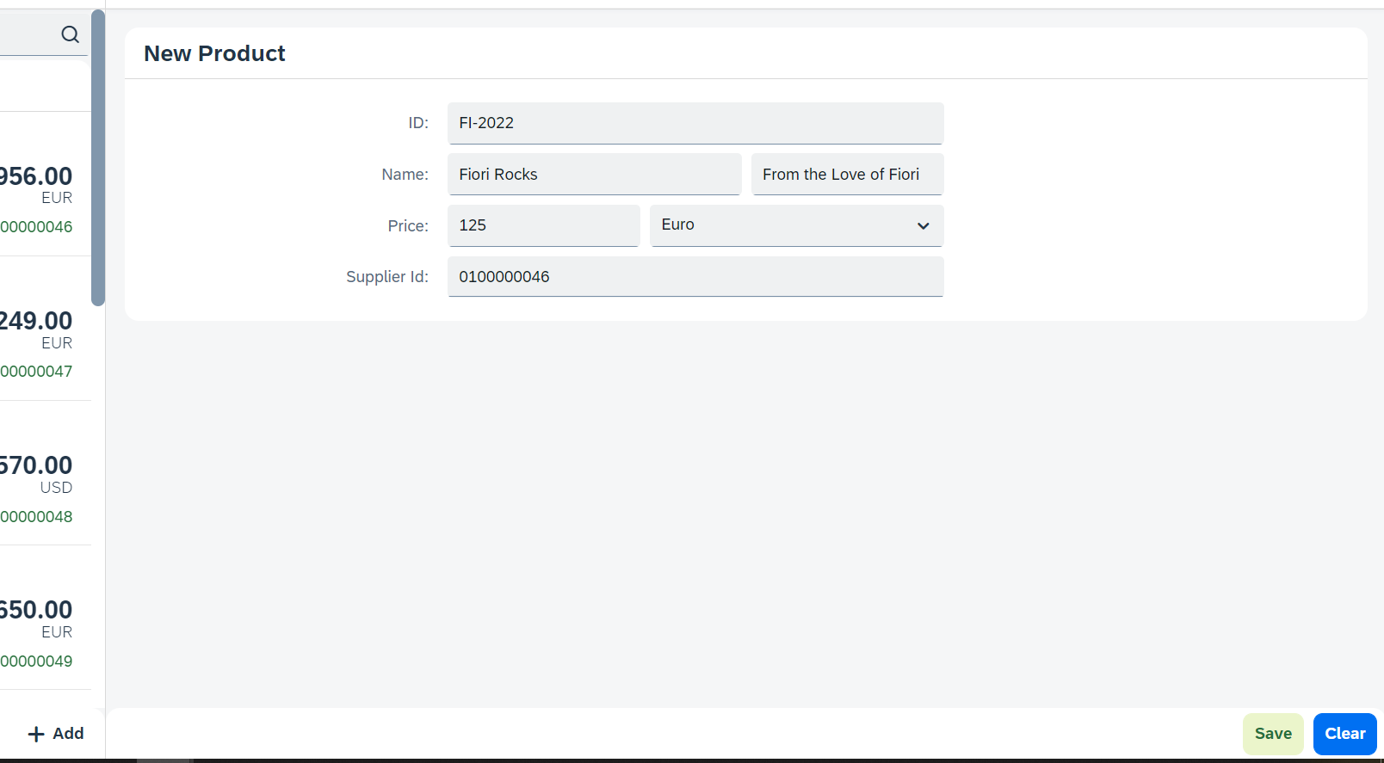
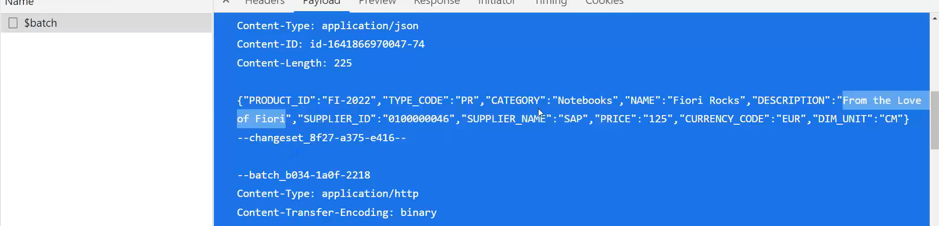
Hands – on: Making POST call from UI
Now we will add a new view named as Add. In this view will add a simple form to enter the product details and then on press of the Save a new Product will be created in the backend.
We will also add a Clear button to clear the form.
Code Link:
View1.view.xml
View1.controller.js
Add.view.xml
Add.controller.js
manifest.json

Slide 9
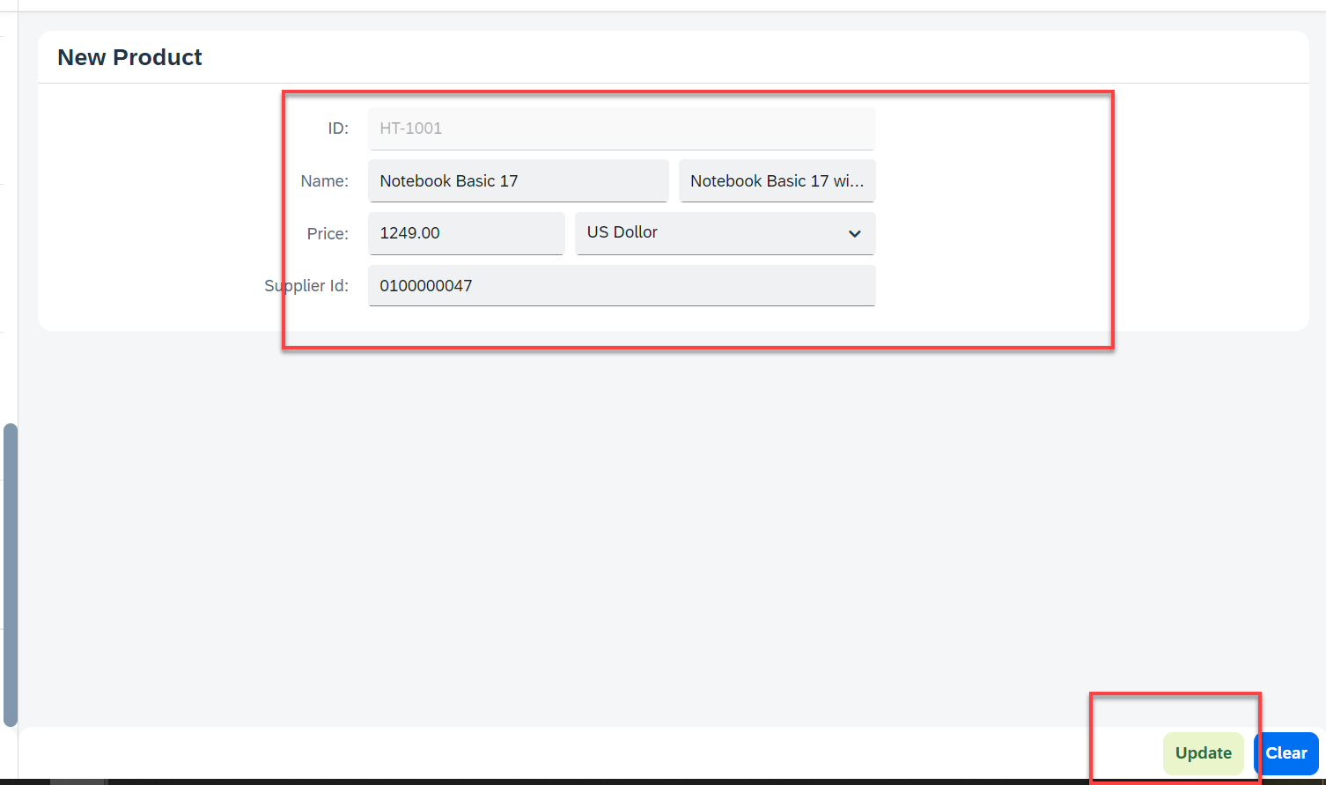
Hands – on: Making Update call form UI
Now will add a functionality to update a Record form the backed. But before that we will have to load the record in the form and then we will update that recode and save it.
Code Links:-
Add.view.xml
Add.controller.js

Slide 10
Title
Content

Slide 11

End of Day 16

Slide 12

Questions

Slide 13

Anubhav Oberoy

Slide 14


We’re committed to empower you to be
Most Desirable Resource
through powerful training solutions.
We build the workforce of the future.
250+
Corporate Clients
30,000+
Learners Trained
25000+
Learners Placed
FREE WEBINARS
Sign up for free webinars with industry experts every fortnight!
Enroll Now!
Contact us today!
https://anubhavtrainings.com/

Slide 15




More from AnubhavTrainings.com

Slide 16
Title
Content

